Slide 1
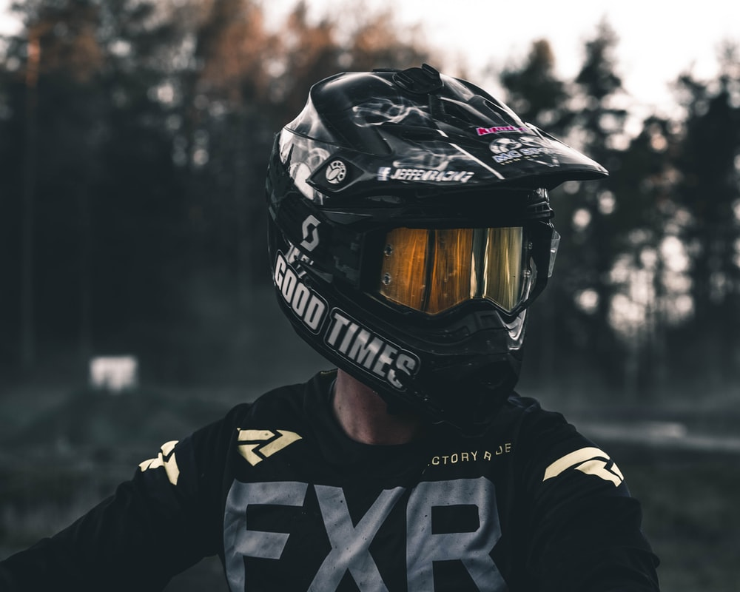
Helmet Detection
Presented to :
prof. Gulzar Ahmed

Slide 2
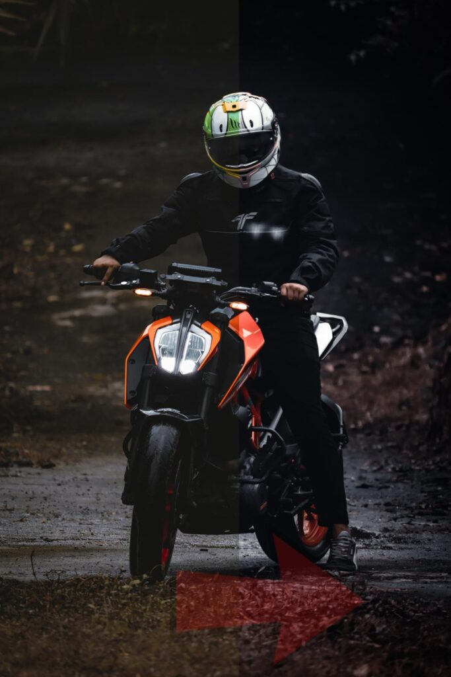
About Group
USAMA BASHARAT
SUBKTGEEN BABAR

Slide 3
Outline
Introduction
Technology
Indicting the people wearing helmet or not during drive on busy roads.
.Yolo v4
.Google Colab
.Darknet
Methodology
Project results
The process how we train our model . What steps are follow to train our model
Sowing some results that we capture from our trained model .

Slide 4
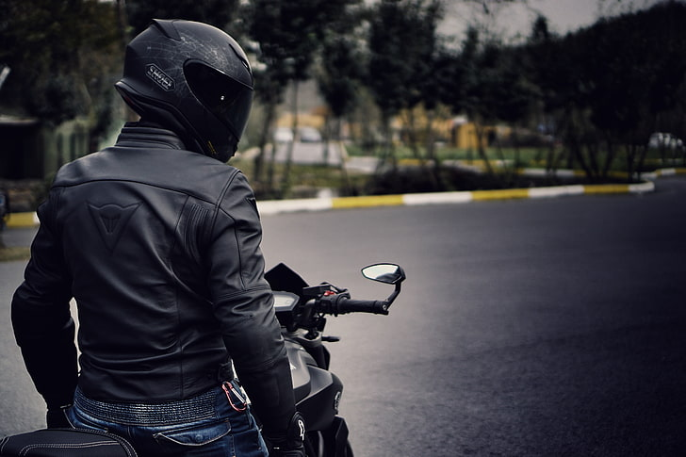
Introduction
To introduce people with the project and gives them the importance of wearing helmet while driving on roads.

Slide 5
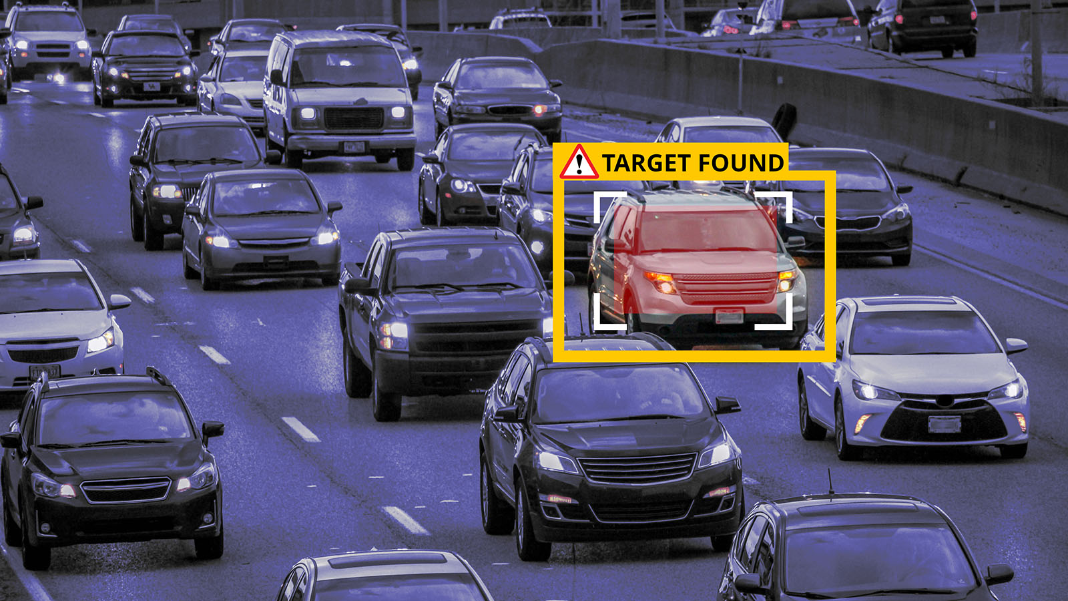
Object Detection
What is Object Detection
Technique for locating the objects and instances in images and videos
Importance of object detection​
We can solve our real world problems virtually by
Training our model

Slide 6


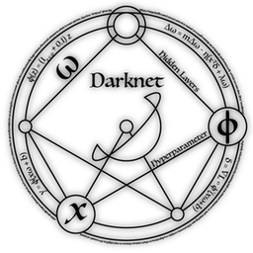

Technologies Used
Yolo v4
Google Colab
Darknet
Python
An efficient real time
Object detection
algorithm
A Google product that allows you to execute
python codes online
Convolutional neural network that work for real time image processor
High level programming
Language with dynamic
semantics

Slide 7
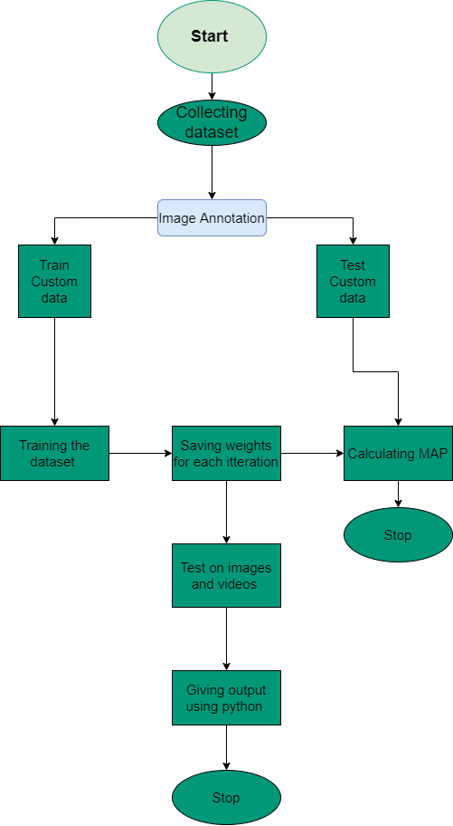
METHODOLOGY

Slide 8
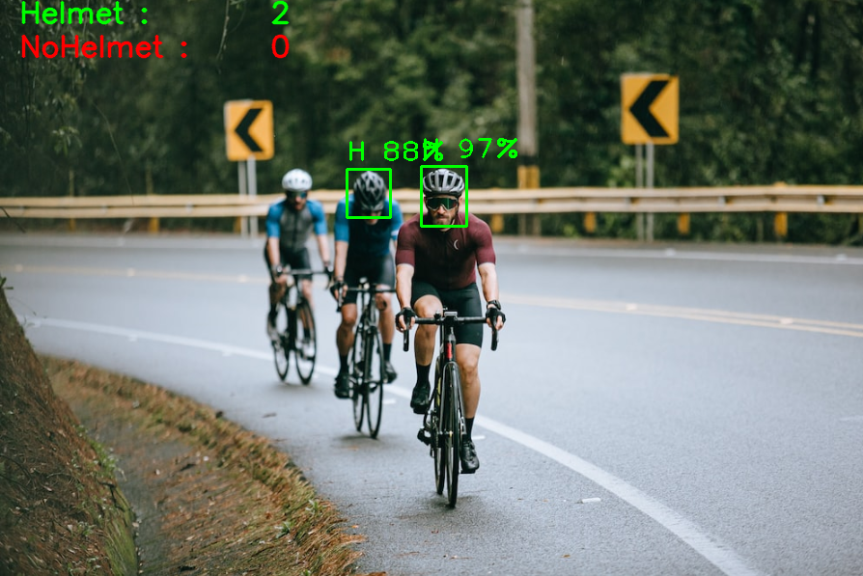
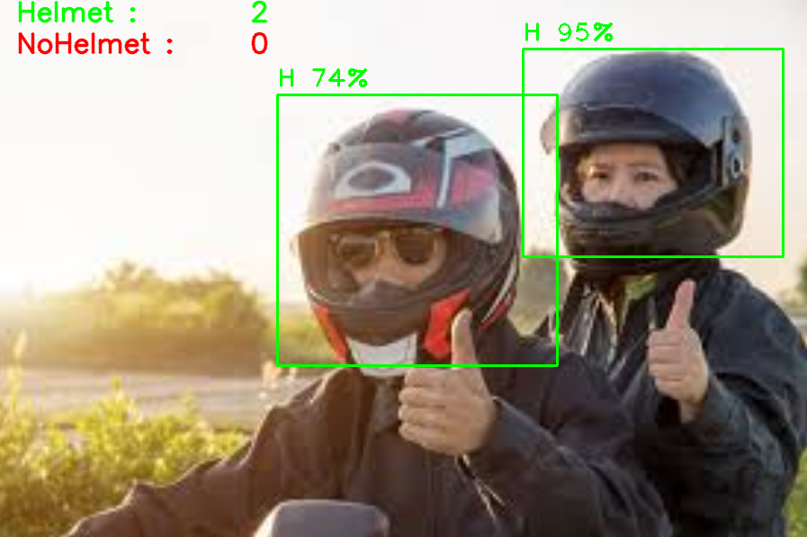
Some Results from training

Slide 9
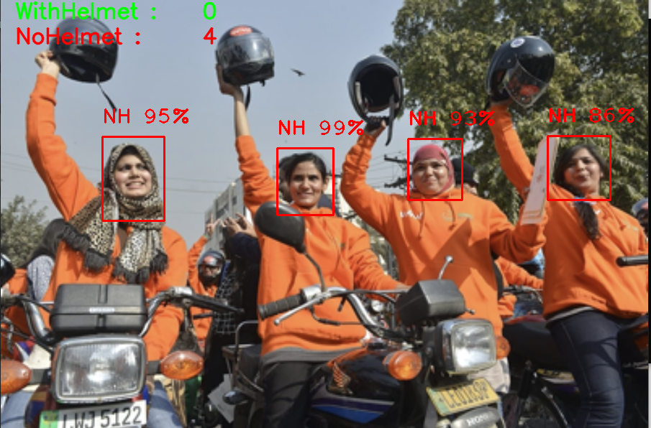
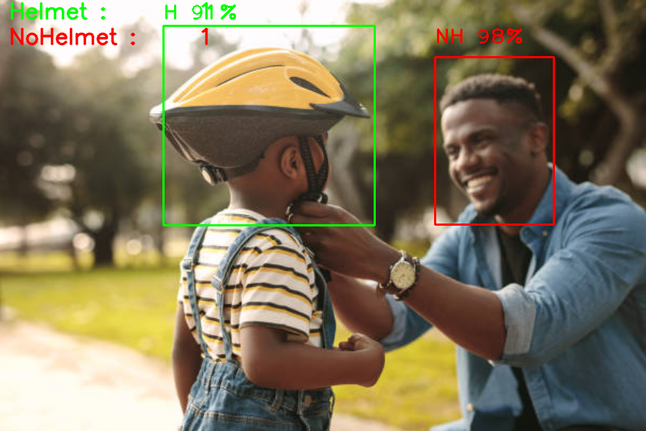
Some Results from training

Slide 10
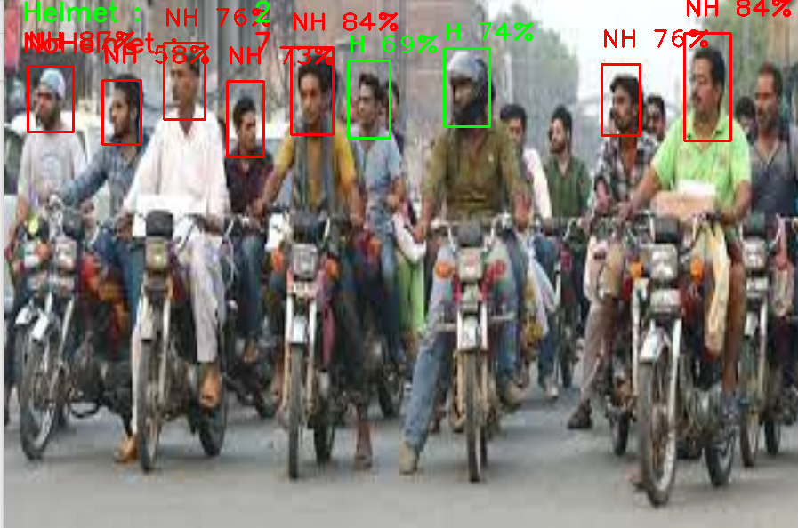
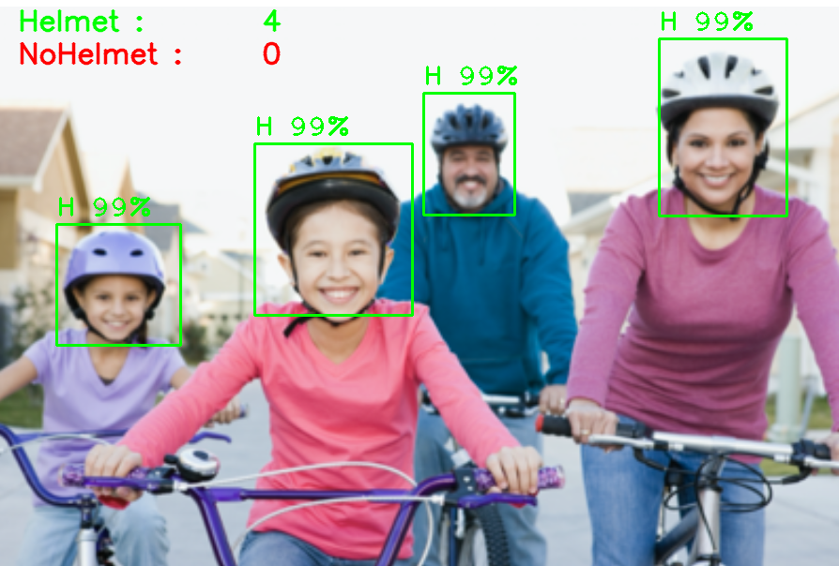
Some Results from training

Slide 11
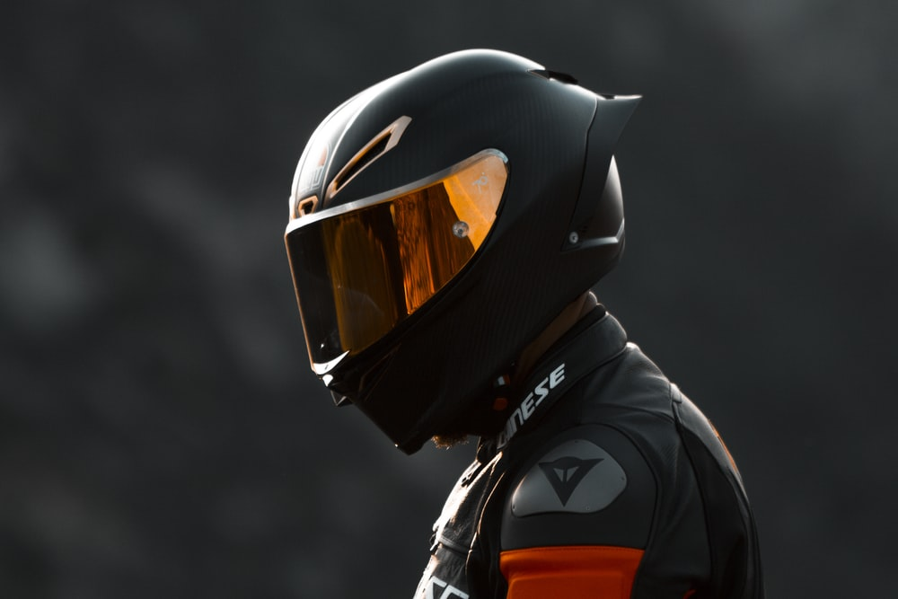
Thank you
Usama Basharat
Subktgeen Babar

